Slide 1
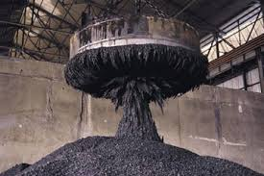
Introduction to Electromagnetism

Slide 2
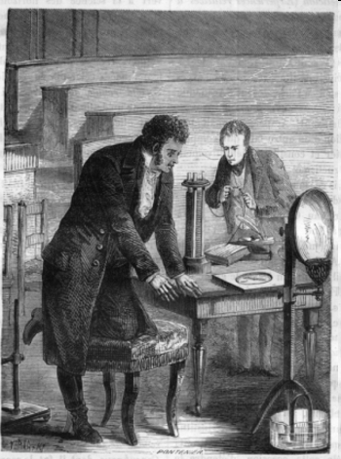
History of Electromagnetism
For centuries, people believed that electricity and magnetism were somehow related. In 1819,
the Danish physicist Hans Christian Oersted (1777–1851) discovered the connection by accident while lecturing on electric circuits at the University of
Copenhagen.

Slide 3
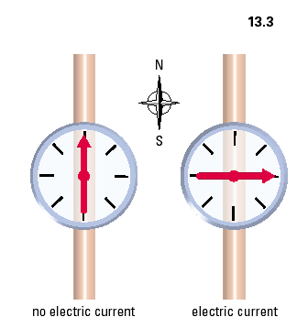
Oersted’s Discovery
Whenever an electric
current moves
through a conductor
(wires), a magnetic field
is created in the region
around the conductor.

Slide 4
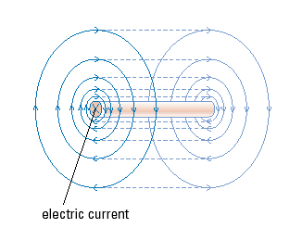
• The magnetic field forms concentric ________ around the wire
circles
farther
The field lines are spaced__________ apart the farther you
are from the wire which shows the field strength is_________.
weaker
The field lines ___________ through space (are 3-D).
extend
The 3D Magnetic Field around a Straight
Conductor

Slide 5


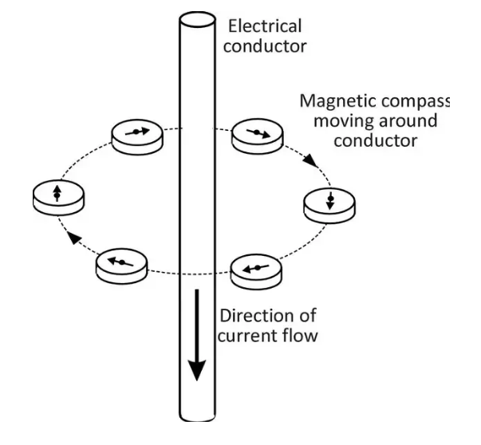
Mapping the Field of a Wire in Two Dimensions
away
Top view- Current going _______ from you
X
towards
Bottom view- Current going _______ you

Slide 6
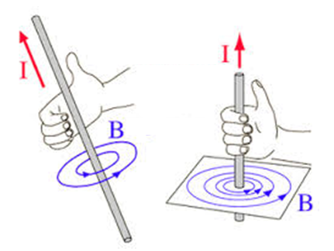
Right Hand Rule #1
Current passing through a straight wire produces a circular magnetic field.
_______________________________
__________________________________
Right thumb-points in current direction
Fingers–curl in direction of the magnetic field
I- direction of conventional current flow
B-magnetic field pattern

Slide 7
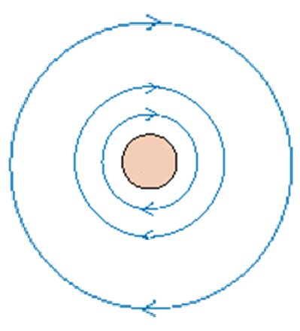
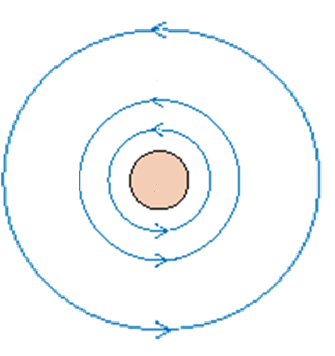
2-D representation:
X
•
Conventional current flows
“into” the page
Conventional current flows
out of the page

Slide 8
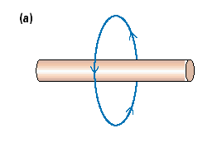
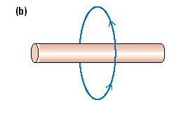
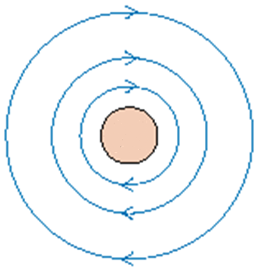
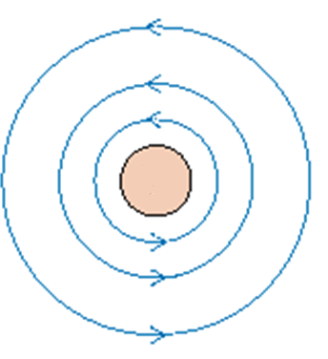
Let’s try…draw the direction of the conventional current in each case.
Conventional Current flows to the right
Conventional Current flows to the left
c) d)
X
Conventional Current flows out of the page!
•
Conventional Current flows into the page!

Slide 9
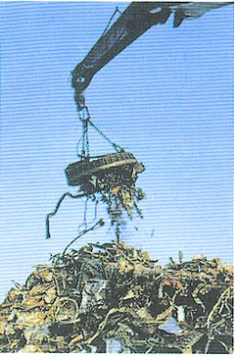
If we can increase the magnetic field around a conductor then we can use the magnetic field!
Electromagnet – an object that exerts a magnetic force when a current is running through it
A crane in a junk yard, can turn its magnetic field off and on to lift a pile of scrap metal and release it using electricity

Slide 10
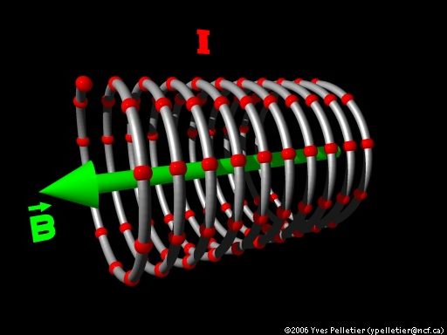
Solenoid
A solenoid represents a coiled loop of wire
Current flows through the coiled loop and creates a magnetic field around the solenoid.
A solenoid is a type
of electromagnet

Slide 11
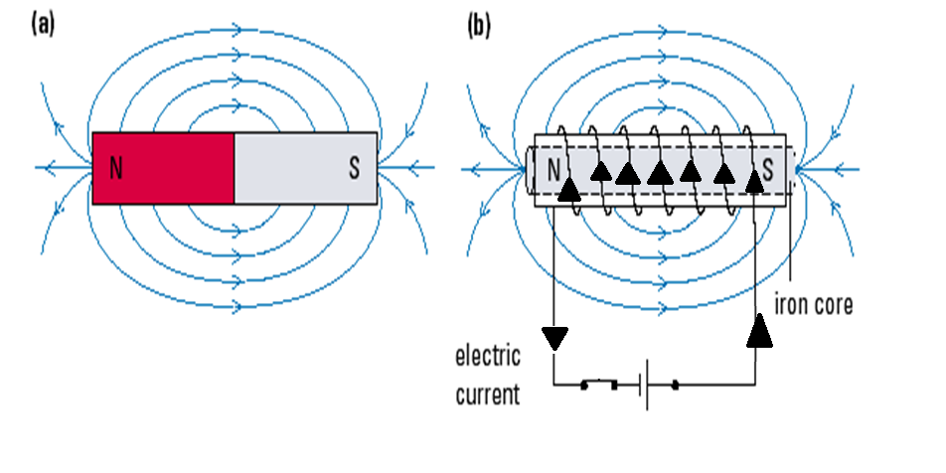
The magnetic field of a solenoid looks like a bar magnet!!
Solenoid

Slide 12
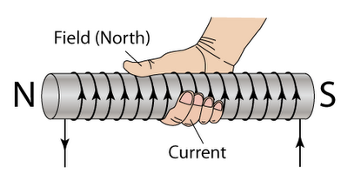
Right Hand Rule #2
•__________ curl in the direction of current flow through the conductor
• _______ points in the direction of the induced magnetic north (N)
Fingers
Thumb

Slide 13
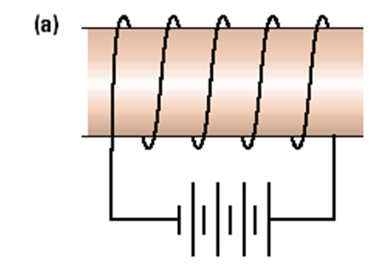
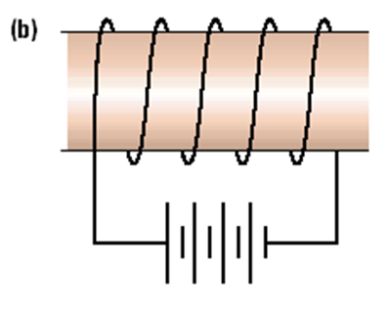
Let’s try...
Indicate on each diagram the direction of the electric current and the north and south poles of the coil.
S
N
N
S

Slide 14
Factors that Determine the Strength of the Magnetic Field
1) Current in the coil, I (I ↑, B ↑)
2) Number of turns in the coil, N (N↑, B ↑)
3) Type of material in the coil’s centre (e.g add a soft iron core)

